Slide 1
CS 235 Data Mining: Winter 2017
Instructor: Dr Eamonn Keogh Computer Science & Engineering Department 318 Winston Chung Hall
University of California - Riverside Riverside, CA 92521
08:10 AM - 09:30 AM
Riverside Campus | Bourns Hall | Room A265
eamonn@cs.ucr.edu Class web page
www.cs.ucr.edu/~eamonn/CS235
Some slides adapted from Tan, Steinbach and Kumar, and from Chris Clifton

Slide 2
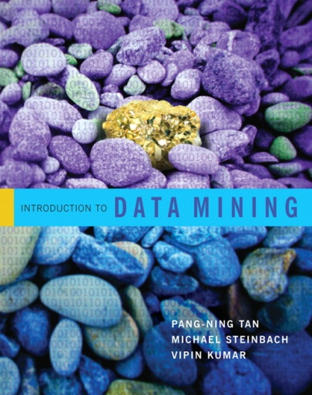



Textbook
Introduction to Data Mining
Pang-Ning Tan,
Michael Steinbach,
Vipin Kumar
Pretty Good
I will use:
Data Mining: The Textbook by Charu C. Aggarwal.
(Not perfect, but the best book out there by a large margin)
However, purchasing it is not compulsory.
Data Mining: Introductory and Advanced Topics
Margaret H. Dunham
Good (a little “basic”)
Data Mining Concepts and Techniques. Jiawei Han, Micheline Kember Not so good

Slide 3
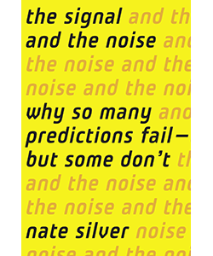

Very useful and interesting book
The Signal and the Noise: The Art and Science of Prediction. Nate Silver
However, purchasing it is not compulsory.
On election day 2012, he predicted Obama had a 90.9% chance of winning a majority in the electoral votes and by crunching polling data he successfully predicted the correct result in 50 out of 50 states.
Before election day 2016, he was the only person giving Trump a significant chance..

Slide 4
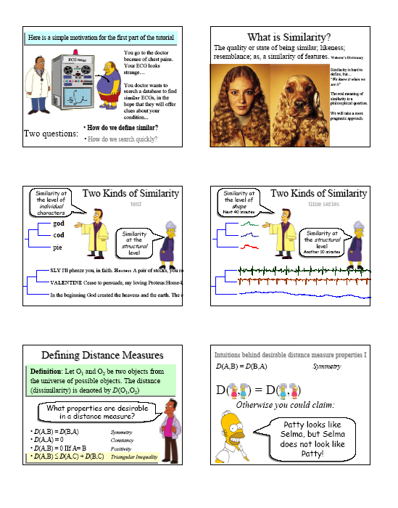
Slides
I make very nice slides, I suggest you print them out 6 per page, before coming to class.
Or, you may follow along on your tablet or laptop.
However, if you are using your tablet or laptop, you may not surf the web or work on emails etc..
90% of the material is on the slides, but the other 10% I will say only in class.

Slide 5
Cheating Policy
Students must read and understand UCR policy on academic honesty. http://www.cs.ucr.edu/curriculum/acad_honest.html
Note, I am very good at detecting cheating (I have taught classes on the subject). Anyone caught cheating will given a final grade of F and may have a letter placed in his or her permanent record. Students are expected to take care that others cannot “cheat off them”. For example, if leave your homework on a shared hard drive or an abandoned floppy and someone else hands it in, you are liable and will have your grade adjusted downward.

Slide 6
Classroom Behavior
I do not want to hear your cell phones during class. First offence will result in the lowering of your final grade by one letter. Second offence will result in a failing grade and removal from class.
Sending or receiving text messages/email, or using the web while in class, will result a failing grade.
Chronic lateness (or leaving class early) is unacceptable (it is disrespectful and disruptive to the instructor and other students). If you are late once, forget about it. The second time you are late you should approach me after class to explain why (failing to do so may result in a 1-percentage point reduction in your grade).

Slide 7
Office Hours
Open door Policy

Slide 8
I will give you a formal syllabus at the next meeting
Grading :
Homework Assignments: ~ 40% (expect about 3)
Programming Assignments: ~ 50% (expect about 3)
Participation / pop quizzes: ~ 10% (expect the unexpected)
I will ask you to read about one paper a week. To make sure you read it. I will either give random pop quizzes, or pick a random person to explain the paper.

Slide 9
Two goals in this class
Primary: Teach you data mining techniques
Secondary: Teach you how to publish papers

Slide 10
Why teach you how to publish papers? I
The skills you need to publish papers, critical thinking, experimental design, literature review etc, are all skills we need to understand and apply data mining techniques.

Slide 11
Why teach you how to publish papers? II
As a practical matter, PhD students need to write two publishable quality papers.
The best way to prove a paper is publishable quality, is to publish it.

Slide 12
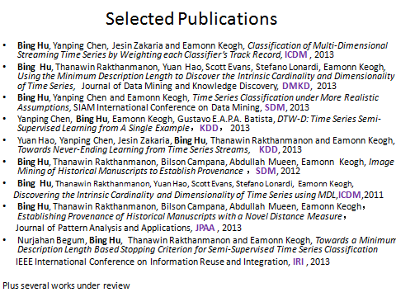

Why teach you how to publish papers?
A strong publication record is your ticket to an interview/job/internship at a top company.

Slide 13

Why me to teach you how to publish papers?
SIGKDD Top Authors
Jiawei Han(68)
Philip S. Yu(57)
Christos Faloutsos(55)
Jieping Ye(44)
Padhraic Smyth(27)
Jian Pei(26)
Wei Fan(26)
Bing Liu 0001(25)
Eamonn J. Keogh(25)
SIAM SDM Top Authors
Philip S. Yu(62)
Charu C. Aggarwal(32)
Jiawei Han(27)
Vipin Kumar(25)
Christos Faloutsos(22)
Wei Fan(22)
Eamonn J. Keogh(21)
ICDM Top Authors
Philip S. Yu(58)
Jiawei Han(42)
Xindong Wu(27)
Eamonn J. Keogh(26)
Zheng Chen(23)
DMKD Top Authors
Eamonn J. Keogh(15)
Jiawei Han(12)
Nikolaj Tatti(10) Aristides Gionis(7) Charu C. Aggarwal(7)
KAIS Top Authors
Philip S. Yu(23)
Jian Pei(12)
Xindong Wu(11)
Eamonn J. Keogh(10)
Hui Xiong(6)

Slide 14
Today's lecture overlaps with section 2.1, 2.2, 2.3 of our book

Slide 15
How much Data is there in the World?
About 4000 exabytes
1 EB is = 1 million terabytes
If printed as texbooks, a stack of books with 4000 Exabytes would reach to Pluto and back 80 times.
At the end of 1999, that number was only about 12 exabytes of data.
(the majority of this data has never been examined by an algorithm, much less a person)

Slide 16
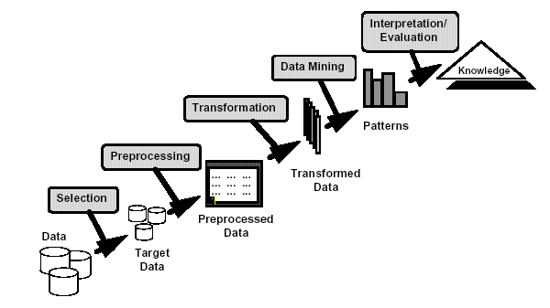
What is Data Mining?
Many Definitions
Non-trivial extraction of implicit, previously unknown and potentially useful information from data
Exploration & analysis, by automatic or semi-automatic means, of large quantities of data in order to discover meaningful patterns

Slide 17
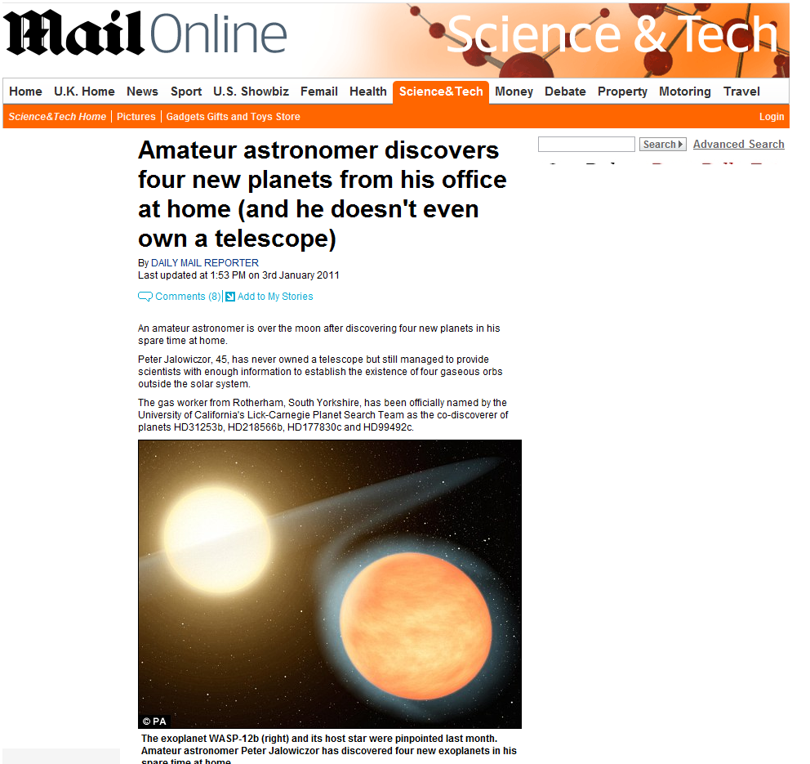
What is Data Mining? Example
Data mining is finding useful information in large datasets.
Key observation: We often data mine datasets that were collected for other purposes.

Slide 18
What is (not) Data Mining?
What is not Data Mining?
Look up phone number by name in a directory (database query)
Query a Web search engine for information about “Amazon” (Information Retrieval)
What is Data Mining?
Certain names are more prevalent in certain US locations (O’Brien, O’Rurke, O’Reilly… in Boston area)
Group together similar documents returned by search engine according to their context (e.g. Amazon rainforest, Amazon.com)

Slide 19
Origins of Data Mining
Draws ideas from machine learning/AI, pattern recognition, statistics, and database systems
Traditional Techniques may be unsuitable due to
Enormity of data
High dimensionality of data
Heterogeneous, distributed nature of data
Statistics/ AI
Machine Learning/
Pattern Recognition
Data Mining
Database systems
The term "Data Mining" appeared around 1990 in the database community.

Slide 20

Why Mine Data? Commercial Viewpoint
Lots of data is being collected and warehoused
Web data, e-commerce
Purchases at department/ grocery stores
Bank/Credit Card transactions
Social media
Computers have become cheaper and more powerful.
Competitive Pressure is Strong
Provide better, customized services for an edge (e.g. in Customer Relationship Management)

Slide 21
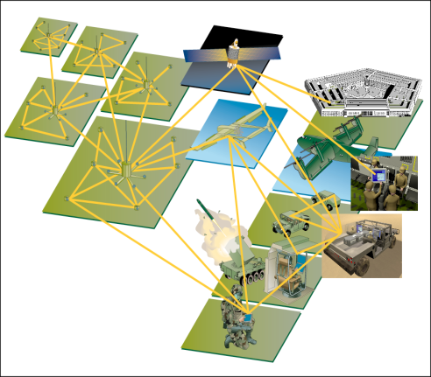
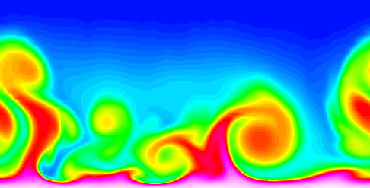
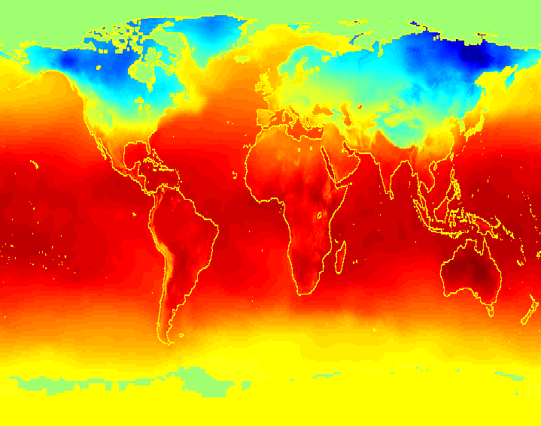
Why Mine Data? Scientific Viewpoint
Data collected and stored at enormous speeds (TB/minute)
remote sensors on a satellite
telescopes scanning the skies
microarrays generating gene expression data
scientific simulations generating terabytes of data
Traditional techniques infeasible for raw data
Data mining may help scientists
in classifying and segmenting data
in Hypothesis Formation
etc

Slide 22
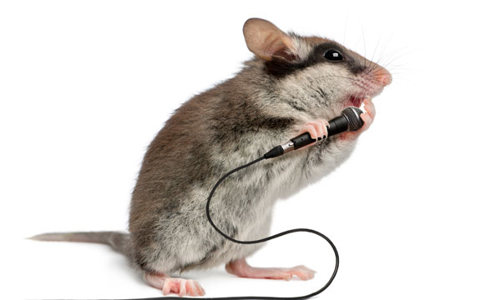
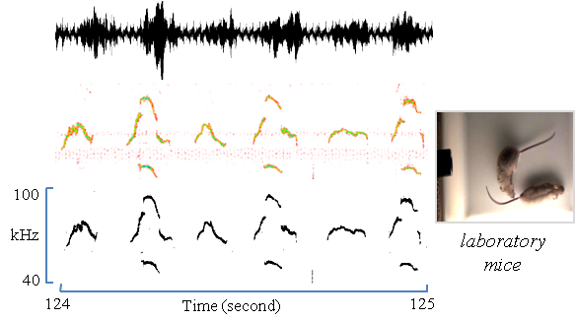
Example
Mice Sing!
Mining Massive Archive of Mice Sounds with Symbolized Representations, Jesin Zakaria, Sarah Rotschafer, Abdullah Mueen, Khaleel Razak, Eamonn Keogh, in the Proceedings of Siam International Conference on Data Mining (SDM) 2012.

Slide 23
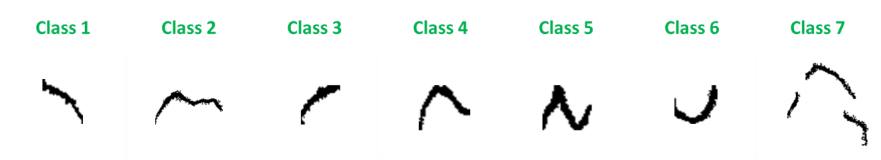
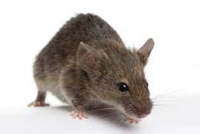
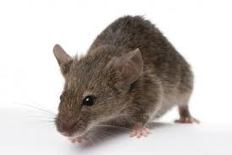
We can deactivate (knock-out, KO) genes in mice, and see what happens to their songs
1- Syllable Extraction
2- Syllable Classification
…1311 … 4521… 13327
…12521 … 12521… 12521
Normal mouse
P53-KO

Slide 24
Mining Large Data Sets - Motivation
There is often information “hidden” in the data that is not readily evident
Human analysts may take weeks to discover useful information, if ever.
Consider this dataset: It is easy to learn the rule “If you take the drug Ephedra and the drug Xanthine, you will die”. This is an example of a rule that a human could data mine from this dataset….
Name | Ephedra | Xanthine | Outcome
Joe | yes | yes | Died
Sue | no | yes | Lived
Cat | yes | yes | Died
Bob | yes | yes | Died
Tim | yes | no | Lived
Jin | no | no | Lived

Slide 25
Mining Large Data Sets - Motivation
Suppose that the dimensionality of the dataset is larger, there are thousands of possible drugs, then the problem becomes much harder.
Name | Ephedra | Xanthine | Aspirin | ….. | Vitamin A | Outcome
Joe | yes | yes | no |  | no | Died
Sue | no | yes | no |  | no | Lived
Cat | yes | yes | yes |  | no | Died
Bob | yes | yes | yes |  | no | Died
Tim | yes | no | no |  | no | Lived
Jin | no | no | yes |  | no | Lived

Slide 26
Mining Large Data Sets - Motivation
Suppose that instead of binary data, some fields contain the dosage given: Now the rules format becomes more complex:
“If you take the drug Ephedra AND more than 30mg of the drug Xanthine, you will die”.
How do we know what the dosage threshold should be?
How do we know which operators to use (AND, OR, NOT, XOR)
Name | Ephedra | Xanthine | Aspirin | ….. | Vitamin A | Outcome
Joe | yes | 100mg | 10mg |  | no | Died
Sue | no | 150mg | 0mg |  | no | Lived
Cat | yes | 100mg | 0mg |  | no | Died
Bob | yes | 100mg | 10mg |  | no | Died
Tim | yes | 25mg | 5mg |  | no | Lived
Jin | no | 20mg | 0mg |  | no | Lived

Slide 27
Mining Large Data Sets - Motivation
Suppose that we have some missing values….
Name | Ephedra | Xanthine | Aspirin | ….. | Vitamin A | Outcome
Joe | yes | 100mg | 10mg |  | no | Died
Sue | no | --- | 0mg |  | no | Lived
Cat | --- | 100mg | 0mg |  | no | ?
Bob | yes | 100mg | 10mg |  | -- | Died
Tim | --- | 25mg | -- |  | no | Lived
Jin | no | 20mg | -- |  | no | Lived

Slide 28
Mining Large Data Sets - Motivation
Suppose that we have ten million records, but only there are only 10 examples of the dangerous drug interaction.
This alone explains why a human will never spot this pattern. A single doctor is unlikely to see more than one of patient die from this interaction in her career. We really do need the power of data mining here.
Name | Ephedra | Xanthine | Aspirin | ….. | Vitamin A | Outcome
Joe | yes | 100mg | 10mg |  | no | Died
Sue | no | --- | 0mg |  | no | Lived
Cat | --- | 100mg | 0mg |  | no | ?
(Ten million records omitted for brevity)
Zhu | yes | 100mg | yes |  | -- | Died
Xin | --- | 25mg | -- |  | no | Lived
Tom | no | 20mg | -- |  | no | Lived

Slide 29
Mining Large Data Sets - Motivation
The problem is compounded by the fact that there are many rules in the data that are true, but not novel or interesting
--People that have babies tend to be females
--Most people have a vowel in their name
--People that are older than 15 years old, are older than 10 years old
Name | Sex | Number of live births | Blood pressure | ….. | Vitamin A | ….
Sue | female | 2 | no |  | no
Joe | male | --- | no |  | no
Ann | female | 3 | yes |  | no
Bob | male | --- | no |  | yes
……

Slide 30
Challenges of Data Mining
Scalability
Dimensionality
Cardinality
Complex and Heterogeneous Data
Data Quality
Data Ownership and Distribution
Privacy Preservation
Streaming Data

Slide 31
If we are going to study data mining, we need to spend a little time taking about data.
This is a little boring, but necessary.

Slide 32
What is Data?
A collection of objects and their attributes
An attribute is a property or characteristic of an object
Examples: eye color of a person, their GPA, their temperature, etc.
Attribute is also known as variable, field, characteristic, or feature
A collection of attributes describe an object
Object is also known as record, point, case, sample, entity, exemplar or instance
Objects could be a customer, a patient, a car, a country, a novel, a drug, a movie etc
Attributes
Objects

Slide 33
Data Dimensionality and Numerosity
The number of attributes is the dimensionality of a dataset.
The number of objects is the numerosity (or just size) of a dataset.
Some of the algorithms we want to use, may scale badly in the dimensionality, or scale badly in the numerosity (or both).
As we will see, reducing the dimensionality and/or numerosity of data is a common task in data mining.
Attributes
Objects

Slide 34
Types of Attributes
There are different types of attributes
Nominal (includes Boolean)
Examples: ID numbers, eye color, zip codes, sex
Ordinal
Examples: rankings (e.g., taste of salsa on a scale from 1-10), grades, height in {tall, medium, short}
Interval
Examples: calendar dates, temperatures in Celsius or Fahrenheit.
Ratio
Examples: temperature in Kelvin, length, time, counts

Slide 35
Properties of Attribute Values
The type of an attribute depends on which of the following properties it possesses:
Distinctness: = ≠
Order: < >
Addition: + -
Multiplication: * /
Nominal attribute: distinctness
Ordinal attribute: distinctness & order
Interval attribute: distinctness, order & addition
Ratio attribute: all 4 properties

Slide 36
Properties of Attribute Values
Nominal attribute: distinctness
We can ask
Jewish = Jewish that is, Is Sue.religion = 2?
Catholic ≠ Muslim
We cannot ask
Jewish < Buddist Even though (2<3)
(Jewish + Muslim)/2
Sqrt(Atheist) Even though Sqrt(1) is allowed
Key:
Atheist: 1
Jewish: 2
Buddist: 3
Name | Religion | Ad
Joe | 1 | 12
Sue | 2 | 61
Cat | 1 | 34
Bob | 3 | 65
Tim | 1 | 54
Jin | 3 | 44

Slide 37
Properties of Attribute Values
Ordinal attribute: distinctness & order
We can say {newborn, infant, toddler, child, teen, adult}
infant = infant
newborn < toddler
We cannot say
newborn + child
infant / newborn
cosine(child)
Key:
newborn: 1
infant: 2
toddler:3
etc
Name | lifestage | Ad
Joe | 1 | 12
Sue | 2 | 61
Cat | 4 | 34

Slide 38
Properties of Attribute Values
There are a handful of tricky cases….
Ordinal attribute: distinctness & order
If we have {Sunday, Monday, Tuesday, Wednesday, Thursday, Friday, Saturday}
Then we can clearly say
Sunday = Sunday
Sunday != Tuesday
But can we say Sunday < Tuesday?
A similar problem occurs with degree of an angle. Consider 365 degrees… Is 5 degrees = 365 degrees?
If this problem shows up, you have to think about the what to do on a case by case basis

Slide 39
Properties of Attribute Values
Interval attribute: distinctness, order & addition
Suppose it is 10 degrees Celsius (for the moment, assume integers)
We can say it is not 11 degrees Celsius
10 ≠ 11
We can say it is colder than 15 degrees Celsius
10 < 15
We can say closing a window will make it two degrees hotter
NewTemp = 10 + 2
We cannot say that it is twice as hot as 5 degrees Celsius
10 / 2 = 5 No!

Slide 40
Properties of Attribute Values
The type of an attribute depends on which of the following properties it possesses:
Ratio attribute: all 4 properties
We can do anything!
So 10_{kelvin} really is twice as hot as 5_{kelvin}
Of course, distinctness is tricky to define with real numbers.
is 3.1415926535897 = 3.141592653589?

Slide 41
Attribute Type
Description
Examples
Operations
Nominal
The values of a nominal attribute are just different names, i.e., nominal attributes provide only enough information to distinguish one object from another. (=, ≠)
zip codes, employee ID numbers, eye color, sex: {male, female}
mode, entropy, contingency correlation, χ² test
Ordinal
The values of an ordinal attribute provide enough information to order objects. (<, >)
hardness of minerals, {good, better, best}, grades, street numbers
median, percentiles, rank correlation, run tests, sign tests
Interval
For interval attributes, the differences between values are meaningful, i.e., a unit of measurement exists. (+, - )
calendar dates, temperature in Celsius or Fahrenheit
mean, standard deviation, Pearson's correlation, t and F tests
Ratio
For ratio variables, both differences and ratios are meaningful. (*, /)
temperature in Kelvin, monetary quantities, counts, age, mass, length, electrical current
geometric mean, harmonic mean, percent variation

Slide 42
Attribute Level
Transformation
Comments
Nominal
Any permutation of values
If all employee ID numbers were reassigned, would it make any difference?
Ordinal
An order preserving change of values, i.e., new_value = f(old_value) where f is a monotonic function.
An attribute encompassing the notion of good, better best can be represented equally well by the values {1, 2, 3} or by { 0.5, 1, 10}, or by {A, B, C}
Interval
new_value =a * old_value + b where a and b are constants
Thus, the Fahrenheit and Celsius temperature scales differ in terms of where their zero value is and the size of a unit (degree).
Ratio
new_value = a * old_value
Length can be measured in meters or feet.

Slide 43
Discrete and Continuous Attributes
Discrete Attribute
Has only a finite or countably infinite set of values
Examples: zip codes, counts, or the set of words in a collection of documents
Often represented as integer variables.
Note: binary attributes are a special case of discrete attributes
Continuous Attribute
Has real numbers as attribute values
Examples: temperature, height, or weight.
As a practical matter, real values can only be measured and represented using a finite number of digits.
Continuous attributes are typically represented as floating-point variables.

Slide 44
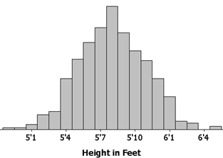
Discrete and Continuous Attributes
We can convert between Continuous and Discrete variables.
For example, below we have converted real-valued heights to ordinal {short, medium, tall}
Conversions of Discrete to Continuous are less common, but sometimes possible.
Why convert? Sometimes the algorithms we what to use are only defined for a certain type of data. For example, hashing or Bloom filters are best defined for Discrete data.
Conversion may involve making choices, for example, how many “heights”, where do we place the cutoffs (equal width, equal bin counts etc.) These choices may effect the performance of the algorithms.
{short, medium, tall}
1, 2, 3
6’3’’
5’1’’
5’7’’
5’3’’
3
1
2
1

Slide 45
In
the
beginning
God
created
the
heaven
and
the
earth.
And
the
earth
was
without
form,
and
void;
and
darkness
was
upon
the
face
of
the
deep.
And
the
Spirit
of
God
moved
upon
the
face
of
The
waters.
And
God
Said
::
::
::
::
::
::
With
you
all.
Amen.
Discrete and Continuous Attributes
We can convert between Discrete and Continuous variables.
For example, below we have converted discrete words to a real-valued time series, that nicely shows when a word ‘bursts’ in a text.
There are 783,137 words in the King James Bible
There are 12,143 unique words in the King James Bible
Local frequency of “God” in King James Bible
x 10
5
0
0
1
2
3
4
5
6
7
8
Genesis
Numbers
Chronicles 1
Jeremiah
Deuteronomy
Revelation
Ezekiel
Notes:
The location of the first word, of each chapter of the King James bible. Genesis starts at 1964 because there is a short preamble
Genesis: 1964
Exodus: 41768
Leviticus: 75671
Numbers: 101077
Deuteronomy: 135265
Joshua: 164579
Judges: 184093
Ruth: 203681
Samuel 1: 206345
Samuel 2: 232215
Kings 1: 253531
Kings 2: 278873
Chronicles 1: 303120
Chronicles 2: 324433
Ezra: 351325
Nehemiah: 359049
Esther: 369939
Job: 375740
Psalms: 394912
Proverbs: 440060
Ecclesiastes: 456014
Solomon: 461823
Isaiah: 464604
Jeremiah: 502941
Lamentations: 546961
Ezekiel: 550534
Daniel: 591212
Hosea: 603173
Joel: 608545
Amos: 610652
Obadiah: 615015
Jonah: 615706
Micah: 617075
Nahum: 620333
Habakkuk: 621665
Zephaniah: 623197
Haggai: 624868
Zechariah: 626037
Malachi: 632692
Matthew: 634598
Mark: 659359
Luke: 675209
John: 702305
Acts: 722280
Romans: 747545
Corinthians 1: 757410
Corinthians 2: 767319
Galatians: 773650
Ephesians: 776892
Philippians: 780078
Colossians: 782374
Thessalonians 1: 784458
Thessalonians 2: 786394
Timothy 1: 787472
Timothy 2: 789838
Titus: 791595
Philemon: 792545
Hebrews: 793009
James: 800214
Peter 1: 802632
Peter 2: 805218
John 1: 806838
John 2: 809465
John 3: 809782
Jude: 810095
Revelation: 810730

Slide 46
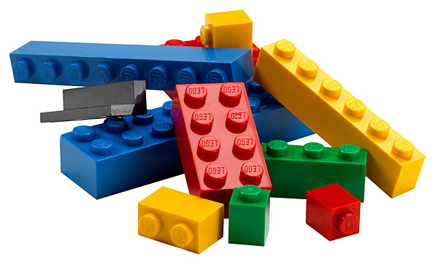
Even if the data is given to you as continuous, it might really be intrinsically discrete
partID | size | Ad
12323 | 7.801 | 12
5324 | 7.802 | 61
75654 | 32.09 | 34
34523 | 32.13 | 65
424 | 47.94 | 54
25324 | 62.07 | 44

Slide 47
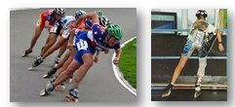
Even if the data is given to you as continuous, it might really be intrinsically discrete
Bing Hu, Thanawin Rakthanmanon, Yuan Hao, Scott Evans, Stefano Lonardi, and Eamonn Keogh (2011). Discovering the Intrinsic Cardinality and Dimensionality of Time Series using MDL. ICDM 2011

Slide 48
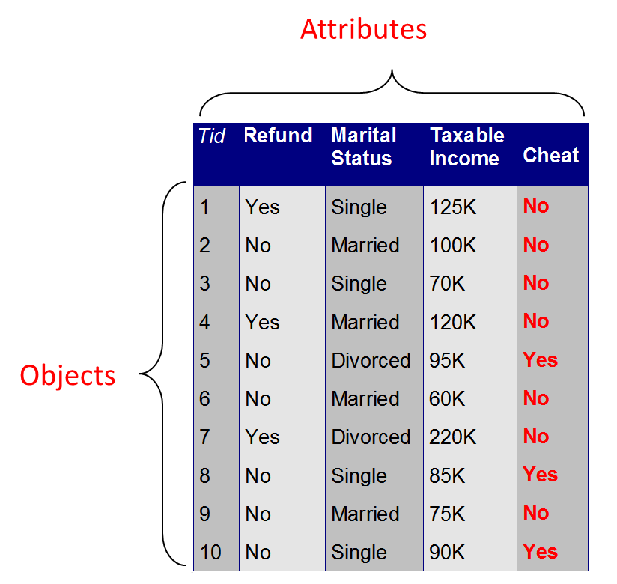
Data can be Missing
Data can be missing for many reasons.
Someone may decline-to-state
The attribute may be the result of an medical expensive test
Sensor failure
etc
Handling missing values
Eliminate Data Objects
Estimate Missing Values
Ignore the Missing Value During Analysis
Replace with all possible values (weighted by their probabilities)
etc

Slide 49
Data can be “Missing”: Special Case
In some case we expect most of the data to be missing.
Consider a dataset containing people’s rankings of movies (or books, or music etc)
The dimensionality is very high, there are lots of movies
However, most people have only seen a tiny fraction of these
So the movie ranking database will be very sparse.
Some platforms/languages explicitly support sparse matrices (including Matlab)
Joe’s ranking of MASH could be missing for two reasons.
He saw it, but did not rank it
He did not see it. Even in this case, the data is considered missing, relatively what his ranking would have been, if he had seen it.
Here, inferring a missing value is equivalent to asking a question like “How much would Joe like the movie MASH?” See “Collaborative filtering” / “ Recommender Systems”
 | Jaws | E.T. | MASH | Ted | Argo |  | Brave | OZ | Bait
Joe | 4 | 1 |  |  |  |  |  | 4
Van |  |  |  | 3 |  |  | 2
Sue | 4 |  | 4
May |  | 5 |  |  | 5 |  |  | 4
June

Slide 50
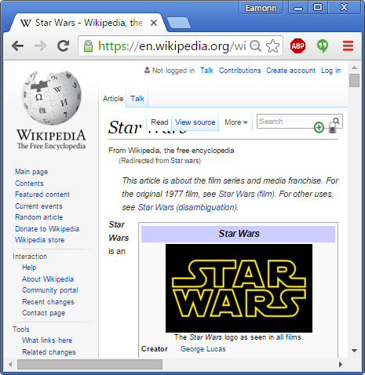
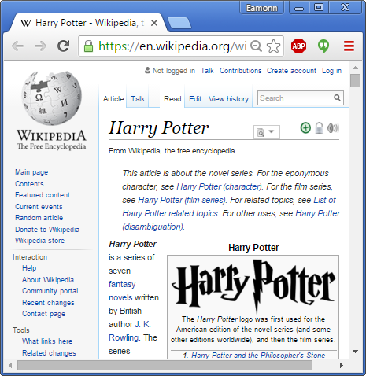
Document Data is also Sparse
Each document is a `term' vector (vector-space representation)
each term is a component (attribute) of the vector,
the value of each component is the number of times the corresponding term occurs in the document.
Doc2
Doc4
document-term matrix
 | the | harry | rebel | god | cat |  | dog | help | near
Doc1 | 42 | 1 |  |  | 1 |  |  | 1
Doc2 | 22 |  | 13 | 1 |  |  | 0
Doc3 | 32 |  |  |  |  |  |  |  | 1
Doc4 | 29 | 56 |  |  | 5 |  |  | 3
Doc5 | 9 |  |  | 1

Slide 51
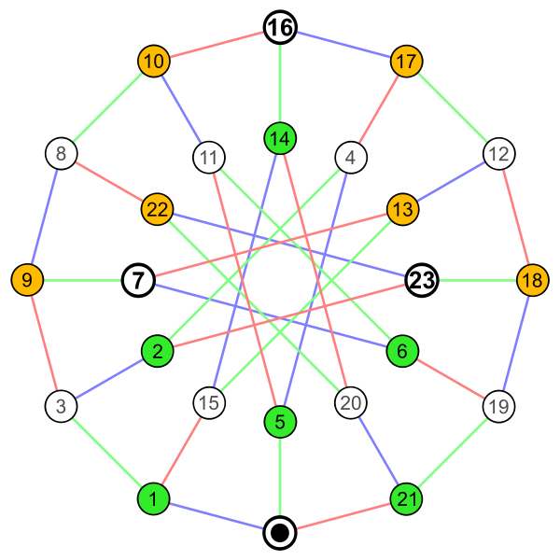
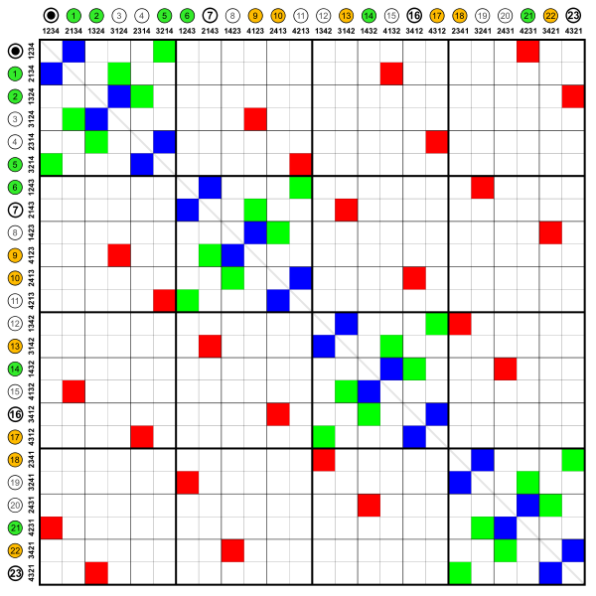
Graph Data is also Typically Sparse
The elements of the matrix indicate whether pairs of vertices are connected or not in the graph.

Slide 52
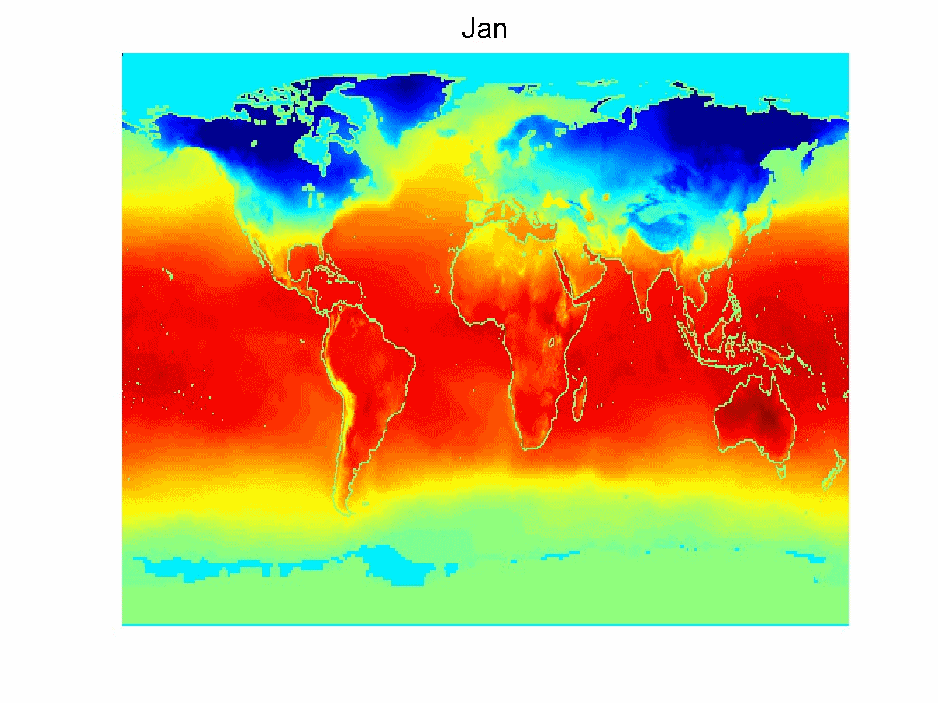
Not all datasets naturally fit neatly into a rectangular matrix (table)
We may have to deal with such data as special cases…
However, we have so many algorithms and tools defined for tables, that we often try to massage all datasets into a table if we can.
DNA Data
First 100 base pairs of the chimp’s mitochondrial DNA:
gtttatgtagcttaccccctcaaagcaatacactgaaaatgtttcgacgggtttacatcaccccataaacaaacaggtttggtcctagcctttctattag
First 100 base pairs of the human’s mitochondrial DNA:
gatcacaggtctatcaccctattaaccactcacgggagctctccatgcatttggtattttcgtctggggggtgtgcacgcgatagcattgcgagacgctg
Transaction Data
Spatio-Temporal Data

Slide 53
Data Quality
What kinds of data quality problems?
How can we detect problems with the data?
What can we do about these problems?
Note, this is just a first look at these issues, we are not going to solve them all today!
Examples of data quality problems:
Redundancy (dependence or association or (informally) correlation)
Noise and outliers
Missing values
Duplicate data

Slide 54
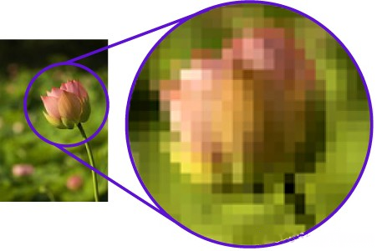
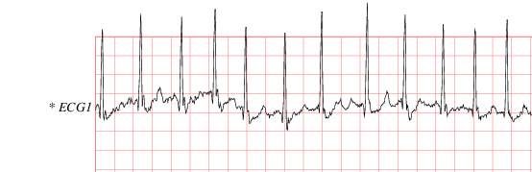
Redundancy
Various subsets of the features are often related or correlated in some way. They are partly redundant with each other.
For problems in signal processing, this redundancy is typically helpful. But for data mining, redundancy almost always hurts.
Two adjacent pixels are typically redundant
Two adjacent values in a time series are typically redundant (autocorrelated)
Your height in feet/inches and your height in meters are highly redundant.
Your height and your inseam are highly redundant.
0.4 | 0.5 | 0.5 | 0.5 | 0.6 | 0.6 | 0.6 | 0.6 | 0.7 | 0.7
 | Height F/I | Height Meters | Weight
1 | 4’10’’ | 1.47 | 166
2 | 6’3’’ | 1.90 | 210
3 | 5’11’ | 1.80 | 215
4 | 5’4’’ | 1.62 | 150

Slide 55
Why Redundancy Hurts
Some data mining algorithms scale poorly in dimensionality, say O(2^{D}). For the problem below, this means we take O(2³) time, when we really only needed O(2²) time.
We can see some data mining algorithms as counting evidence across a row (Nearest Neighbor Classifier, Bayes Classifier etc). If we have redundant features, we will “overcount” evidence.
It is probable that the redundant features will add errors.
For example, suppose that person 1 really is exactly 4’10’’. Then they are exactly 1.4732m, but the system recorded them as 1.47m . So we have introduced 0.0032m of error. This is a tiny amount, but it we had 100s of such attributes, we would be introducing a lot of error.
The curse of dimensionality (discussed later in the quarter)
As we will see in the course, we can try to fix this issue with data aggregation, dimensionality reduction techniques, feature selection, feature generation etc
 | Height F/I | Height Meters | Weight
1 | 4’10’’ | 1.47 | 166
2 | 6’3’’ | 1.90 | 210
3 | 5’11’ | 1.80 | 215
4 | 5’4’’ | 1.62 | 150

Slide 56
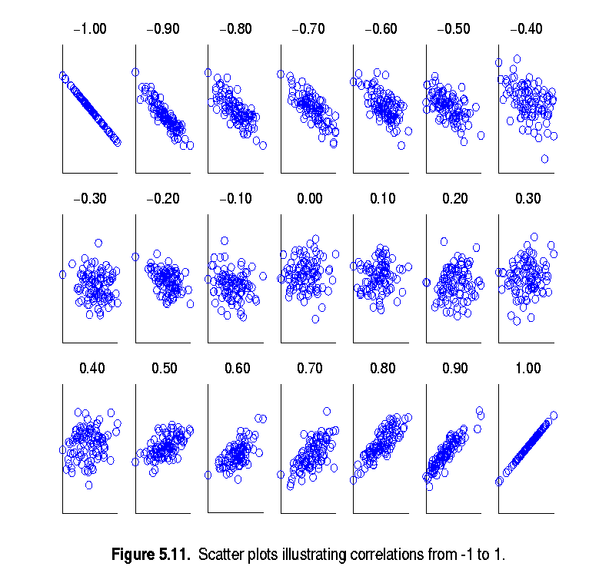
Detecting Redundancy
By creating a scatterplot of “Height F/I” vs. “Height Meters” we can see the redundancy, and measure it with correlation.
However, if we have 100 features, we clearly cannot visual check 100² scatterplots.
Note that two features can have zero correlation, but still be related/redundant. There are more sophisticated tests of “relatedness”.
Again, linear correlation is a special type of redundancy, not the only type.
 | Height F/I | Height Meters | Weight
1 | 4’10’’ | 1.47 | 166
2 | 6’3’’ | 1.90 | 210
3 | 5’11’ | 1.80 | 215
4 | 5’4’’ | 1.62 | 150
Height Meters
Height F/I

Slide 57
Visually Detecting (Linear) Correlation I
 | Height F/I | Height Meters | Weight
1 | 4’10’’ | 1.47 | 166
2 | 6’3’’ | 1.90 | 210
3 | 5’11’ | 1.80 | 215
4 | 5’4’’ | 1.62 | 150

Slide 58
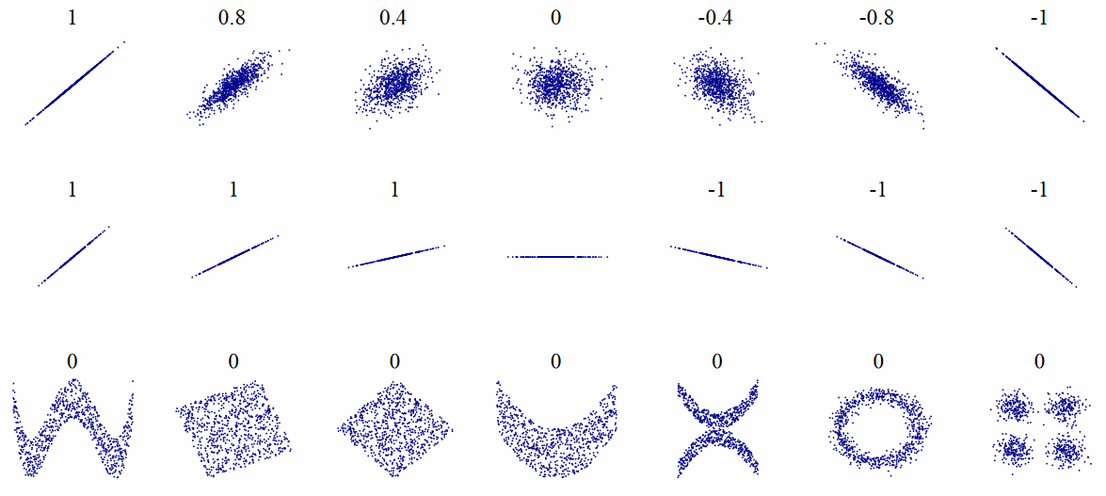
Visually Detecting (Linear) Correlation II
As the plot below shows, two features can be highly dependent, without having any correlation.

Slide 59
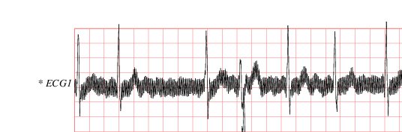
Noise
Noise refers to modification of original values
Examples: distortion of a person’s voice when talking on a poor quality phone.
 | Height Meters | Weight
1 | 1.47 | 166
2 | 1.90 | 210
3 | 180 | 215
4 | 1.62 | 150
This man is not really 180 meters tall!
The two images are one man’s ECGs, taken about an hour apart. The different are mostly due to sensor noise
(MIT-BIH Atrial Fibrillation Database record afdb/08405)

Slide 60
Now that we understand the basic data format, we can preview a high-level view of the four most fundamental problems in data mining. These problems correspond to:
Clustering
Classification
Association pattern mining
Outlier detection

Slide 61
Consider this dataset.
Note that the attribute for “Insect Class” for record ten is missing. What should it be?
This is the classification problem.
Algorithms used to solve it include:
Nearest Neighbor
Decision Trees
Neural Nets
Bayesian Classifier
Linear Classifiers
etc
Insect ID | Abdomen Length | Antennae Length | Insect Class
1 | 2.7 | 5.5 | Grasshopper
2 | 8.0 | 9.1 | Katydid
3 | 0.9 | 4.7 | Grasshopper
4 | 1.1 | 3.1 | Grasshopper
5 | 5.4 | 8.5 | Katydid
6 | 2.9 | 1.9 | Grasshopper
7 | 6.1 | 6.6 | Katydid
8 | 0.5 | 1.0 | Grasshopper
9 | 8.3 | 6.6 | Katydid
10 | 8.1 | 4.7

Slide 62
Given a data matrix D, partition its rows (records) into sets C₁ . . . C_{k}, such that the rows (records) in each cluster are “similar” to one another.
This is the clustering problem (one solution on next page)
Algorithms used to solve it include:
K-means
Hierarchical Clustering
Dbscan
Density peaks
Etc
Insect ID | Abdomen Length | Antennae Length
1 | 2.7 | 5.5
2 | 8.0 | 9.1
3 | 0.9 | 4.7
4 | 1.1 | 3.1
5 | 5.4 | 8.5
6 | 2.9 | 1.9
7 | 6.1 | 6.6
8 | 0.5 | 1.0
9 | 8.3 | 6.6
10 | 8.1 | 4.7
11 | 6.7 | 6.1
12 | 2.5 | 1.6
13 | 8.4 | 5.1

Slide 63
Given a data matrix D, partition its rows (records) into sets C₁ . . . C_{k}, such that the rows (records) in each cluster are “similar” to one another.
This is the clustering problem.
What does “similar” mean?
Here I chose k = 2 sets, but in general, what is the best k?
Insect ID | Abdomen Length | Antennae Length
1 | 2.7 | 5.5
2 | 8.0 | 9.1
3 | 0.9 | 4.7
4 | 1.1 | 3.1
5 | 5.4 | 8.5
6 | 2.9 | 1.9
7 | 6.1 | 6.6
8 | 0.5 | 1.0
9 | 8.3 | 6.6
10 | 8.1 | 4.7
11 | 6.7 | 6.1
12 | 2.5 | 1.6
13 | 8.4 | 5.1
10
9
8
7
6
5
Antenna Length
4
3
2
1
1
2
3
4
5
6
7
8
9
10
Abdomen Length

Slide 64
Given a binary n × d data matrix D, determine all subsets of columns such that all the values in these columns take on the value of 1 for at least a fraction s of the rows in the matrix.
The relative frequency of a pattern is referred to as its support.
The fraction s is referred to as the minimum support.
This is Frequent Pattern Mining (association rule mining)
ID | Bread | Milk | Batteries | Juice | Butter
1 | 1 | 0 | 0 | 0 | 1
2 | 0 | 1 | 0 | 0 | 0
3 | 1 | 0 | 0 | 0 | 0
4 | 0 | 0 | 1 | 0 | 0
5 | 0 | 1 | 0 | 0 | 0
6 | 0 | 0 | 0 | 0 | 0
7 | 1 | 0 | 0 | 0 | 1
8 | 0 | 0 | 1 | 0 | 0
9 | 0 | 1 | 1 | 0 | 0
10 | 1 | 1 | 0 | 0 | 1

Slide 65
Given a binary n × d data matrix D, determine all subsets of columns such that all the values in these columns take on the value of 1 for at least a fraction s of the rows in the matrix.
The relative frequency of a pattern is referred to as its support.
The fraction s is referred to as the minimum support.
This is Frequent Pattern Mining.
It seems that bread and butter are often purchased together
ID | Bread | Milk | Batteries | Juice | Butter
1 | 1 | 0 | 0 | 0 | 1
2 | 0 | 1 | 0 | 0 | 0
3 | 1 | 0 | 0 | 0 | 0
4 | 0 | 0 | 1 | 0 | 0
5 | 0 | 1 | 0 | 0 | 0
6 | 0 | 0 | 0 | 0 | 0
7 | 1 | 0 | 0 | 0 | 1
8 | 0 | 0 | 1 | 0 | 0
9 | 0 | 1 | 1 | 0 | 0
10 | 1 | 1 | 0 | 0 | 1

Slide 66
Are there any unusual records in this data?
This is the outlier detection problem.
Insect ID | Abdomen Length | Antennae Length | Insect Class
1 | 2.7 | 5.5 | Grasshopper
2 | 8.0 | 9.1 | Katydid
3 | 0.9 | 4.7 | Grasshopper
4 | 1.1 | 3.1 | Grasshopper
5 | 5.4 | 8.5 | Katydid
6 | 0.5 | 9.9 | Grasshopper
7 | 6.1 | 6.6 | Katydid
8 | 0.5 | 1.0 | Grasshopper
9 | 8.3 | 6.6 | Katydid
10 | 8.1 | 8.2 | Katydid

Slide 67
Are there any unusual records in this data?
This is the outlier detection problem.
It seems that record 6 is an outlier. Not that the individual values for the two attribute are not unusual, but their combination is.
10
9
Insect ID | Abdomen Length | Antennae Length | Insect Class
1 | 2.7 | 5.5 | Grasshopper
2 | 8.0 | 9.1 | Katydid
3 | 0.9 | 4.7 | Grasshopper
4 | 1.1 | 3.1 | Grasshopper
5 | 5.4 | 8.5 | Katydid
6 | 0.5 | 9.9 | Grasshopper
7 | 6.1 | 6.6 | Katydid
8 | 0.5 | 1.0 | Grasshopper
9 | 8.3 | 6.6 | Katydid
10 | 8.1 | 8.2 | Katydid
8
7
6
Antenna Length
5
4
3
2
1
1
2
3
4
5
6
7
8
9
10
Abdomen Length

Slide 68
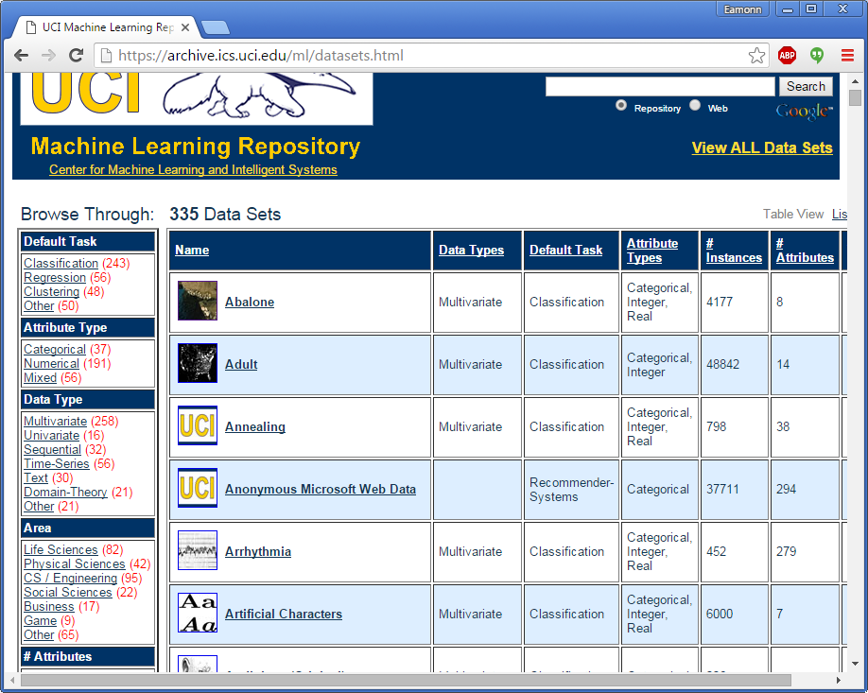
Homework
Look at a few of the 355 datasets in the UCI repository
https://archive.ics.uci.edu/ml/datasets.html
Be prepared for a (un) surprise quiz on Thursday, in which you..
Write 2 to 5 sentences explain what the dataset is.
The Synthetic Control Chart Time Series Data Set is a time series dataset. As the name implies, it is not real data but synthetic. However it is suppose to be a good proxy for real data that comes from CNC machines.
There are no missing values.
Tell me the dimensionality of the data. The dimensionality (the length of the time series) is 60.
Tell me the numerosity of the data. There are 600 examples, divided into 6 types.
Tell me the data type(s) in the dataset. (could all be one type, could be mixed) . All the data objects are real-valued (ratio)
Tell me at least one data mining task this dataset was used for.
This dataset was used by Alcock and Manolopoulos in a paper published in 1999 (HCI) to demonstrate a classification algorithm.

Slide 69
Blue: “God” -English Bible
Red: “Dios” -Spanish Bible
x 10
5
0
0
1
2
3
4
5
6
7
8
Genesis
Numbers
Chronicles 1
Ezekiel
Jeremiah
Revelation
Deuteronomy
Gray: “El Senor” -Spanish Bible
Notes:
The location of the first word, of each chapter of the King James bible. Genesis starts at 1964 because there is a short preamble
Genesis: 1964
Exodus: 41768
Leviticus: 75671
Numbers: 101077
Deuteronomy: 135265
Joshua: 164579
Judges: 184093
Ruth: 203681
Samuel 1: 206345
Samuel 2: 232215
Kings 1: 253531
Kings 2: 278873
Chronicles 1: 303120
Chronicles 2: 324433
Ezra: 351325
Nehemiah: 359049
Esther: 369939
Job: 375740
Psalms: 394912
Proverbs: 440060
Ecclesiastes: 456014
Solomon: 461823
Isaiah: 464604
Jeremiah: 502941
Lamentations: 546961
Ezekiel: 550534
Daniel: 591212
Hosea: 603173
Joel: 608545
Amos: 610652
Obadiah: 615015
Jonah: 615706
Micah: 617075
Nahum: 620333
Habakkuk: 621665
Zephaniah: 623197
Haggai: 624868
Zechariah: 626037
Malachi: 632692
Matthew: 634598
Mark: 659359
Luke: 675209
John: 702305
Acts: 722280
Romans: 747545
Corinthians 1: 757410
Corinthians 2: 767319
Galatians: 773650
Ephesians: 776892
Philippians: 780078
Colossians: 782374
Thessalonians 1: 784458
Thessalonians 2: 786394
Timothy 1: 787472
Timothy 2: 789838
Titus: 791595
Philemon: 792545
Hebrews: 793009
James: 800214
Peter 1: 802632
Peter 2: 805218
John 1: 806838
John 2: 809465
John 3: 809782
Jude: 810095
Revelation: 810730

Slide 70
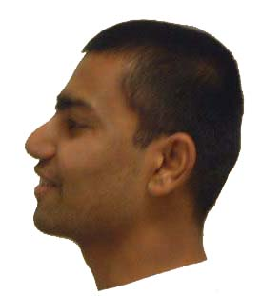
Image data, may best be thought of as time series…
Notes:
Ratanamahatana. C. A & Keogh, E. (2004). Using Relevance Feedback in Multimedia Databases. In the proceedings of the 7th International Conference on Visual Information Systems
Pierre Maurel and Guillermo Sapiro (2003). Dynamic shapes average. Institute for Mathematics and its Application.
Thomas G. Dietterich and Ashit Gandhi, . Content-Based Image Retrieval: Plant Species Identification using Dynamic Programming. http://web.engr.oregonstate.edu/~tgd/leaves/

Slide 71
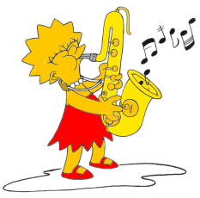
SAX
Continuous Attributes, with dimensionality of 128
0
20
40
60
80
100
120
baabccbc
Discrete Attributes, with dimensionality of 8, and a cardinality of 3

Slide 72
SAX
C
C
0
20
40
60
80
100
120
First convert the time series to PAA representation, then convert the PAA to symbols
It takes linear time
c
c
c
b
b
b
a
a
-
-
0
0
20
40
60
80
100
120
baabccbc

Slide 73

A change of representation is a fundamental data mining trick
bcabaabca
ccabaacca
bcabaabca

